Slide 1
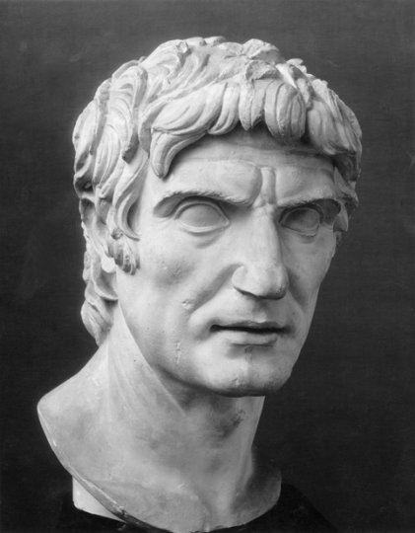
Sulla’s First March on Rome
GOAL/S: Analyse Sulla’s first March on Rome
Week 1, Lesson 4

Slide 2
Watch the following:
https://www.youtube.com/watch?v=yvsWfrg0NMU&ab_channel=EraEpics

Slide 3

Class Discussion
What do we already know about sulla’s first march on rome?
Think about: Key people, key events, key ideas

Slide 4
Today’s Lesson - INSTRUCTIONS
As a class, read through and complete the activities provided
Task Booklet – Sulla’s First March on Rome

